Slide 1


www.opengroup.org
Classification: Unrestricted
Notes:
Transcript
This is another video brought to you by The Open Group Healthcare Forum, which you can visit at www.opengroup.org

Slide 2

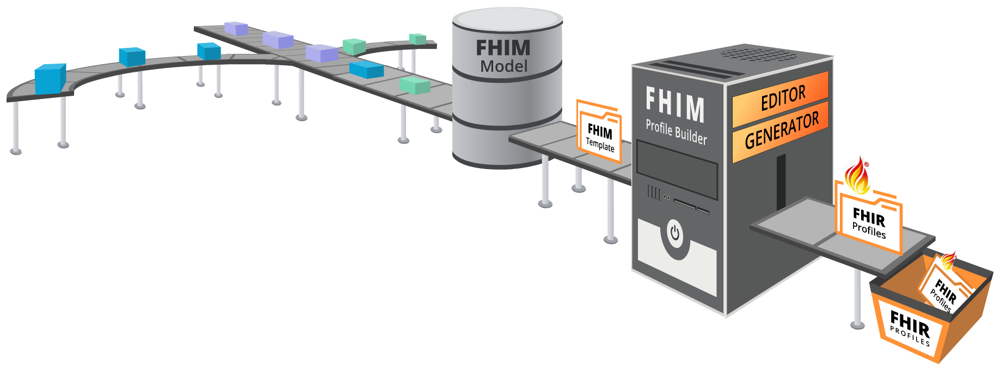
FHIM Profile Builder Process
2. Information
Modeling
3. Terminology
Modeling
1. Use Cases
4. FHIM Profile Builder
5. FHIR
Profiles
Classification: Unrestricted
Notes:
Transcript
This conceptual slide demonstrates the FHIM Profile Builder operations; where,
First, the FHIM Profile Builder(™) leverages the FHIM—its harmonization of standards via information and terminology modeling—for use in specific implementations.
Second, to make the FHIM easier to use, it provides a web-based Profile Editor to identify the information needed for an exchange.
And third, it provides a Profile Generator that interfaces with the Editor and produces F-H-I-R, pronounced “FIRE” profiles that are consistent and re-useable. . .

Slide 3

FHIM Profile Builder™ (FPB)
FPB Profile Editor
Ioana Singureanu, Healthcare IT Developer
at Eversolve LLC
Classification: Unrestricted
Federated Health Information Model
Notes:
FPB Profile Editor Demonstration-Video Transcript
Iona Singureanu, Software Developer, Eversolve LLC
2019-08-20
This is a brief demo of the web-based template editor, proposed for the FHIM Profile Builder.
This is a very simple web-application that allows users to create templates based on FHIM class content and then generate FHIR profiles from those templates.
The first screen shows you the login screen.
Right now, the only authorization provider supported is Google.
So, we login with our Google credentials.
Next, the search screen allows us to search through the FHIM model for certain classes by name, by organization ID, and by other criteria.
In this case we're going to look for a class called immunization report.
If we provide a sub-string, we're going to get more matches.
The more precise the search string the more-narrow the scope of searches.
Here we're going to see, in the response bundle, any structures that match this name.
So, the structure may be a class as in this case immunization report is a class but there may also be a set of existing templates.
This approach would ensure that users don’t create duplicate templates by accident, so, they would be able to see the class and the entire family of templates, based on that class.
If they choose to edit an existing class or an existing template, they can select the template.
But, if they wish to create a new template from the immunization report, they will select the class itself and they will see all the data elements available in this class, ten entries at a time, and by default the data element is going to show supported unless the use case is a mix of mandatory, in which case, we make sure that this information is present in the underlying profile, or perhaps not supported.
So, encounter in this case, is not supported in the immunization report.
We then add meta data elements related to the usage of this template.
For example, they are going to say a “Big-org” and an implementation guide “Big-IG” and a template name that maybe “my immunization”, and a business-specific business-relevant version of this template. In this case it might be version 1.0 since this is the first time we have created the template.
Notice that the generate FHIR profile button is not enabled, until we save the template and make sure it's been stored in the FHIM repository.
So, now, we can go in and we can invoke the generator, and when we generate a FHIR profile we will get access to a structure definition resource, consisting of the FHIR representation of all the data elements in our template
And, we can examination it and we can store it locally or we can, in the future, register it to an official national registry of profiles, as necessary.
So, once we cancel out of this, we can now go back and make changes to existing templates, we can add new templates based on other classes, and when we're done with all the work, we just logout.

Slide 4




Thank You!
We look forward to your participation
j.lee@opengroup.org
(774) 444-0880
@jasonsleephd
Classification: Unrestricted
Notes:
Transcript
Thank you for watching this introduction to the FHIM Profile Builder. We have just started to demonstrate its value. Please join us as we further develop this important tool.

